Slide 1
Beyond Identification, Toward Continuous Pervasive Spaces: Exploiting Tag Multiplicity for Passive RFID Distributed Physical Information Systems
Monday, May 23, 2011
Victor K.Y. Wu

Slide 2
Agenda
Refer to Table of Contents handout

Slide 3

1 Introduction
Image credit: Ellick Chan

Slide 4
1.1 Thesis: Exploiting Tag Multiplicity
Passive RFID enables the design and implementation of continuous pervasive spaces. In particular, a large number of tags, that is, passive RFID tag multiplicity, allows us to design and deploy robust, distributed physical information systems, achieving this particular goal of pervasivity.

Slide 5
1.2 Pervasive Computing and Pervasive Spaces
Ubiquitous/pervasive computing
Active spaces, Gaia (2003 Roman et al)
Mobile Gaia (2004 Shankar et al, 2005 Chetan et al)
Super spaces (2004 Al-Muhtadi et al)

Slide 6
1.2.1 Device-centric View
Three key ingredients in pervasive spaces
Communication and data flow
Data storage
Computation

Slide 7
1.2.1 Device-centric View (cont.)
Time
Full-fledged Computers
Smart Mobile Devices
Active Sensors
Active RFID
Passive Sensors
Passive RFID
NFC
Space
Space-time spectrum of key ingredients in pervasive devices

Slide 8
1.2.2 Environment-centric View
Presence and heterogeneity of devices results in added cognitive load
Discretization is problem
Increase granularity, perceive continuity
Continuous pervasive spaces (CPS)

Slide 9
1.2.2 Environment-centric View (cont.)
Time
Granularity
Passive Tag-based Information System
Mobile Gaia
Super Spaces
Space
Granularity
Space-time granularity spectrum of key ingredients in systems for pervasive spaces

Slide 10
1.2.3 Characteristics of CPS
Provide a set of rich services for users
Rich services are elastic in their availability and integrity
User is minimally distracted
Supporting system is distributed and scalable
Fault-tolerant
Energy-efficient and cost-efficient

Slide 11
1.2.4 Competition: Not Sufficiently Continuous
NFC
Active RFID
Active Sensors
Passive Sensors
Smart mobile devices and computers

Slide 12
1.2.5 Distributed Physical Information Systems
Passive RFID
Physical
Information system
Distributed
“Tag-based information system”

Slide 13
1.3. Thesis Re-iterated
Passive RFID enables the design and implementation of continuous pervasive spaces. In particular, a large number of tags, that is, passive RFID tag multiplicity, allows us to design and deploy robust, distributed physical information systems, achieving this particular goal of pervasivity.

Slide 14
1.4 Applications and Related Work
RFID in pervasive computing
Supply chain management
Tracking and localization
Storage and collaboration

Slide 15
1.5 Supporting and Related Technologies
Passive UHF and supply chain management
Passive RFID storage
Tag singulation
Mobile interrogation
Networking

Slide 16

2 Tracking Protocols
Image credit: Wikipedia (http://en.wikipedia.org/wiki/File:Sea.king.northdevon.arp.750pix.jpg)

Slide 17
2.1 Space-time Correlations
Tags densely distributed in field
Tags in floors and walls
User with interrogator moves field, scans tags
Space-time correlations (vectors)
Direction indicates user movement
Weight is correlation
Leave digital trails

Slide 18
2.1.1 System Model
Tags not storage-limited
Each tag has position
Each tag has unique ID

Slide 19
2.1.2 Correlation Functions
Space-time correlation functions (vectors)
Store vectors in tags inline
Vectors retrieved later for tracking
Position of tag may be necessary
Stored beforehand inline
Estimate relative positions

Slide 20
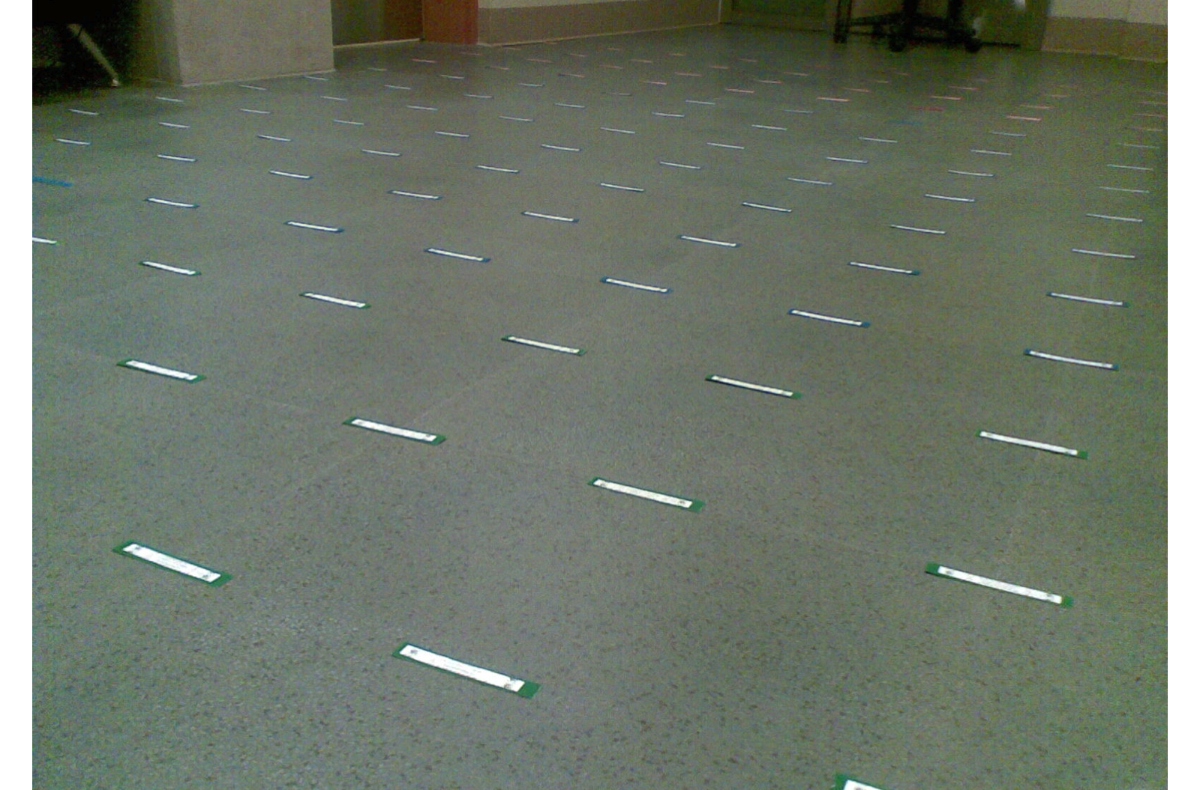
2.1.2 Correlation Functions (cont.)

Slide 21
2.1.2 Correlation Functions (cont.)
“Entrance” and “exit” times of tag
Stationary tags, mobile users
User only encounters a tag once
Six correlation functions
Weight and direction

Slide 22
2.1.2 Correlation Functions (cont.)
Weights

Slide 23
2.1.2 Correlation Functions (cont.)
Directions

Slide 24
2.1.2 Correlation Functions (cont.)
Correlation functions

Slide 25
2.1.3 Experimental Evaluation

Slide 26
2.1.3 Experimental Evaluation (cont.)

Slide 27
2.1.3 Experimental Evaluation (cont.)
Average weight-normalized arrow error

Slide 28
2.1.3 Experimental Evaluation (cont.)
Average weight-normalized arrow error change

Slide 29
2.1.3 Experimental Evaluation (cont.)
Arrow field with d(new) from one experiment run; Antenna power = P2

Slide 30
2.1.3 Experimental Evaluation (cont.)
Arrow field with d(cen) from one experiment run; Antenna power = P1

Slide 31
2.1.3 Experimental Evaluation (cont.)
Arrow field with d(cen) from one experiment run; Antenna power = P2

Slide 32
2.1.3 Experimental Evaluation (cont.)
Arrow field with d(cen) from one experiment run; Antenna power = P3

Slide 33
2.1.3 Experimental Evaluation (cont.)
Arrow field with d(sar,new) from one experiment run; Antenna power = P3

Slide 34
2.1.3 Experimental Evaluation (cont.)
Arrow field with d(sar,cen) from one experiment run; Antenna power = P3

Slide 35
2.1.3 Experimental Evaluation (cont.)

Slide 36
2.2 Forest Search and Rescue
Tags densely distributed in forest
Search and rescue for lost forest hikers
Focus on replacement algorithms for finite-storage tags
Digital paths composed of increasing SNs
(ID, SN) pairs
Physical gaps caused by environmental damage

Slide 37
2.2 Forest Search and Rescue (cont.)

Slide 38
2.2.1 Related Work
Tree tour (2003 Hoyt)
Forestry and logging industries (Discover RFID)
CenWits (2005 Huang)

Slide 39
2.2.2 Replacement Algorithms
Oldest Selection (OS)
Random Selection (RS)
Highest Frequency Selection (HFS)
Lowest Delete Frequency Selection (LDFS)

Slide 40
2.2.3 System Analysis
Geometric version of system
Line segment of length
Linear tag density tags/m;
All tags already full
How a path erodes

Slide 41
2.2.3 System Analysis (cont.)

Slide 42
2.2.3 System Analysis (cont.)

Slide 43
2.2.3 System Analysis (cont.)

Slide 44
2.2.3 System Analysis (cont.)

Slide 45
2.2.4 System Simulation
Yosemite Valley hiking trails
Widths of trails are one meter
Spatial tag density is
Each tag has memory slots
Randomly choose one of six paths

Slide 46
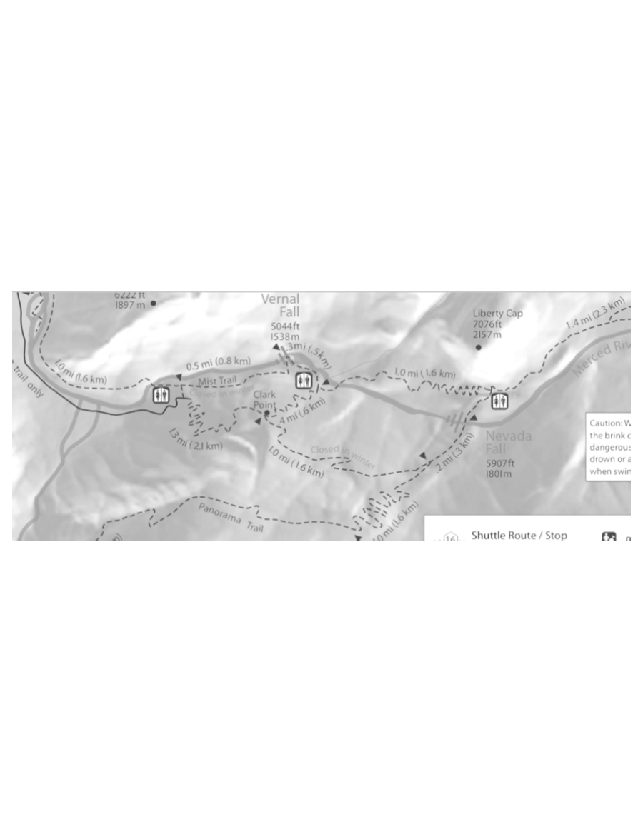
2.2.4 System Simulation (cont.)

Slide 47
2.2.4 System Simulation (cont.)
Original hiker selects path one; moves through and stores digital trail
Next 24 hikers move through, eroding the original trail

Slide 48
2.2.4 System Simulation (cont.)
Fraction of remaining tags with (ID, SN) pairs of the first hiker;

Slide 49
2.2.4 System Simulation (cont.)
Fraction of remaining tags with (ID, SN) pairs of the first hiker;

Slide 50
2.2.4 System Simulation (cont.)
Fraction of remaining tags with (ID, SN) pairs of the first hiker;

Slide 51
2.2.4 System Simulation (cont.)
Search metric

Slide 52
2.2.4 System Simulation (cont.)
Search metric;

Slide 53
2.2.4 System Simulation (cont.)
Search metric;

Slide 54
2.2.4 System Simulation (cont.)
Search metric;

Slide 55
2.2.5 Proposed System Implementation Issues
Centralized extreme
Distributed extreme
Realistic implementation is in between

Slide 56
2.3 Continuous Pervasivity

Slide 57
2.3.1 Quality of Tracking Services
Trails have varying characteristics
Customizable tracking services
Adjustable tracker algorithms
Tracker operation spectrum

Slide 58
2.3.2 Distributedness
Tag deployment is elastic
Flexible tag density
Fault-tolerant
Tags and interrogators are distributed agents

Slide 59
2.4 Concluding Remarks
Two scenarios to study tracking protocols
Infinite storage space
Space-time correlations
Finite storage space
Replacement algorithms

Slide 60
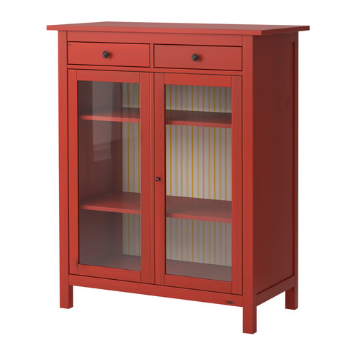
3 Storage Access Protocols
Image credit: Ikea (http://www.ikea.com/us/en/images/products/hemnes-linen-cabinet-red-glass__0105685_PE253176_S4.JPG)

Slide 61
3 Storage Access Protocols (cont.)
Leverage tag storage
Desire black-box approach
User is oblivious to physical layer and storage constraints
Two scenarios
Dense tag deployment
Moderate tag deployment

Slide 62
3.1 Efficient Access Protocols (cont.)
Dense tag deployment
One interrogator scan captures many tags
Need efficient access
Read new, overwrite old
Borrow aloha and query tree
Static and dynamic cases

Slide 63
3.1.1 Static Case – System Model
tags fixed in area
Each tag stores one message and timestamp
Interrogators arrive, scan (read and write), and leave
Inter-arrival time >> tag access time

Slide 64
3.1.1 Static Case – System Model (cont.)
During each stay, write messages (and associated timestamps)
First write to empty tags, then overwrite, starting with oldest

Slide 65
3.1.2 Static Case – Storage Access Algorithms
Focus on reading
Find newest messages in tags
Aloha-based algorithms
Aloha-normal
Aloha-max
Aloha-half
Query tree-based algorithms
Query tree-normal
Query tree-max

Slide 66
3.1.2 Static Case – Storage Access Algo (cont.)
Aloha
Singulation in multiple query rounds
Estimate tag population
Lookup table to store

Slide 67
3.1.2 Static Case – Storage Access Algo (cont.)

Slide 68
3.1.2 Static Case – Storage Access Algo (cont.)
Aloha-normal
Singulate all tags using aloha
Tags respond with IDs and timestamps
Queries newest tags
Aloha-max
In each query round, keep track of largest timestamp so far; suppress tags accordingly
Effective tag population size changing

Slide 69
3.1.2 Static Case – Storage Access Algo (cont.)
Aloha-max
Need to know statistics of interrogators

Slide 70
3.1.2 Static Case – Storage Access Algo (cont.)
Aloha-half
Instead of largest timestamp, use median timestamp as cut-off time
Don’t need to know statistics of interrogators

Slide 71
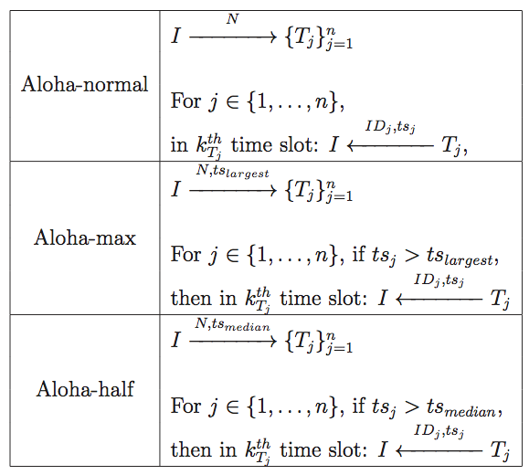
3.1.2 Static Case – Storage Access Algo (cont.)

Slide 72
3.1.2 Static Case – Storage Access Algo (cont.)
Query tree
Prefix matching in multiple rounds
Query tree-normal
Singulate and then tag access
Query tree-max
In each query round, keep track of largest timestamp so far; suppress tags accordingly

Slide 73
3.1.3 Static Case – Simulations
Message access time
Count simultaneous bits transferred over the air and possible bits transferred (i.e. time elapsed)
Do not count actual data transfer
96 bit EPC
17 bit timestamp (24 hour period, second precision)
3 bits for

Slide 74
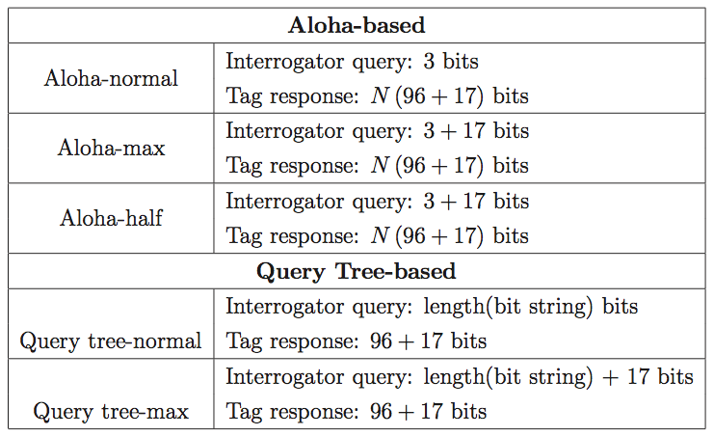
3.1.3 Static Case – Simulations (cont.)

Slide 75
3.1.3 Static Case – Simulations (cont.)
Number of simultaneous bits transmitted for the static case

Slide 76
3.1.3 Static Case – Simulations (cont.)
Number of simultaneous bits transmitted; Aloha-based algorithms

Slide 77
3.1.3 Static Case – Simulations (cont.)
Number of simultaneous bits transmitted; Query tree-based algorithms

Slide 78
3.1.3 Static Case – Simulations (cont.)
Number of simultaneous bits transmitted;

Slide 79
3.1.4 Dynamic Case – System Model
Tags arrive as a system
Steady state,
Some tags empty at “steady state” (contrast with static case)
Tags have finite storage (not just single storage with static case)
Same model for interrogators

Slide 80
3.1.4 Dynamic Case – System Model (cont.)
Encode messages, byte-wise
Write chunks to different tags
Chunk sequence numbers are bits
Timestamp serves as message ID
Tag storage is FIFO queue
When writing, spread out chunks as much as possible, to empty tags first

Slide 81
3.1.5 Dynamic Case – Storage Access Algorithms

Slide 82
3.1.5 Dynamic Case – Storage Access Algo (cont.)
Aloha-normal
Singulate all tags
Read chunk by chunk, across tags
Recover messages
Query tree-normal
Singulate tags
Read chunk by chunk, across tags
Recover messages

Slide 83
3.1.5 Dynamic Case – Storage Access Algo (cont.)
Query tree-max
Two stages in each query round
In first stage, find largest timestamp
In second stage, singulate on tags that have that timestamp

Slide 84
3.1.6 Dynamic Case – Simulations
Measured message lifetime per byte
Message access time per byte
96 bit EPC
17 bit timestamp
3 bits for
chunks,
Each chunk needs 8 + 5 + 17 = 30 bits
512 bits storage per tag
slots per tag

Slide 85
3.1.6 Dynamic Case – Simulations (cont.)
Average measured message lifetime per byte;
p = 1/2 and = 0.2 arrivals per second

Slide 86
3.1.6 Dynamic Case – Simulations (cont.)
Average measured message lifetime per byte;
p = 1/2 and = 0.6 arrivals per second

Slide 87
3.1.6 Dynamic Case – Simulations (cont.)
Average message access time per byte;
p = 1/2, = 0.2 arrivals per second, and k = 16 bytes

Slide 88
3.1.6 Dynamic Case – Simulations (cont.)
Average message access time per byte;
p = 1/2, = 0.2 arrivals per second, and k = 20 bytes

Slide 89
3.1.6 Dynamic Case – Simulations (cont.)
Average message access time per byte;
p = 1/2, = 0.2 arrivals per second, and k = 24 bytes

Slide 90
3.1.6 Dynamic Case – Simulations (cont.)
Average message access time per byte;
p = 1/2, = 0.2 arrivals per second, and k = 28 bytes

Slide 91
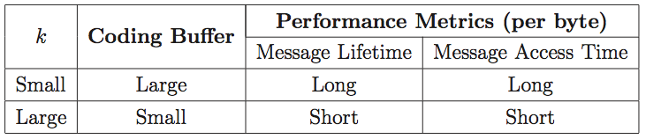
3.1.6 Dynamic Case – Simulations (cont.)

Slide 92
3.2 Random Access Protocols
More moderate tag distribution
Random access file system
In general case, multiple physical spaces
Also consider privacy
Privacy of content
“Practical minimalist cryptography” (2007 Langheinrich)

Slide 93
3.2.1 Motivating Application Domains
Storage: Small-scale and large-scale
Communications
One-way and two-way
Local-online combination

Slide 94
3.2.2 Strategies for Privacy and Redundancy
Trivial encryption and redundancy
Adding chaff
Redundancy encoding
Multi-space distributed systems
Structured communication network
Ad-hoc flat architecture communication network

Slide 95
3.2.3 System Description
File encryption and encoding
File name encryption and chunk identifiers
File writing
File reading

Slide 96
3.2.4 Experimental Evaluation

Slide 97
3.2.4 Experimental Evaluation (cont.)

Slide 98
3.2.4 Experimental Evaluation (cont.)
128 tags, EPCs
Starting
File size chunks
Tag storage size chunks
Codeword always 32 chunks

Slide 99
3.2.4 Experimental Evaluation (cont.)
Initially generate 10 EPC lists
Scan board 10 times to generate each list
Record time to generate each list
“Scan times”

Slide 100
3.2.4 Experimental Evaluation (cont.)
Generate file
File chunks, chunk number, chunk tag key
Write file
Inventory tags (randomly pick an EPC list)
Round chunk tag keys to EPCs, write data
Record system utilization
Fraction of filled tag chunk slots

Slide 101
3.2.4 Experimental Evaluation (cont.)
Record recovery time per byte
Inventory tags (randomly pick an EPC list)
Round chunk tag keys to EPCs, read data
Record file lifetime information progression
File decay over time

Slide 102
3.2.4 Experimental Evaluation (cont.)
Tag scan frequency;

Slide 103
3.2.4 Experimental Evaluation (cont.)
Tag scan frequency;

Slide 104
3.2.4 Experimental Evaluation (cont.)
Tag scan frequency;

Slide 105
3.2.4 Experimental Evaluation (cont.)
File write period per byte;

Slide 106
3.2.4 Experimental Evaluation (cont.)
File write period per byte;

Slide 107
3.2.4 Experimental Evaluation (cont.)
File write period per byte;

Slide 108
3.2.4 Experimental Evaluation (cont.)
System utilization;

Slide 109
3.2.4 Experimental Evaluation (cont.)
System utilization;

Slide 110
3.2.4 Experimental Evaluation (cont.)
System utilization;

Slide 111
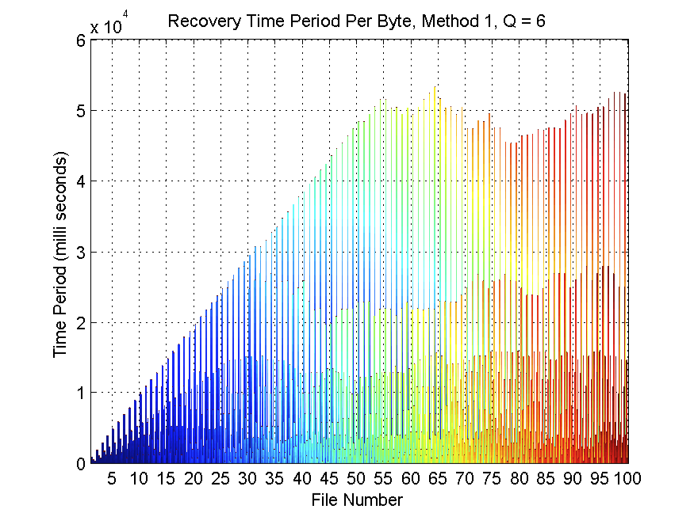
3.2.4 Experimental Evaluation (cont.)
Recovery time period per byte;

Slide 112
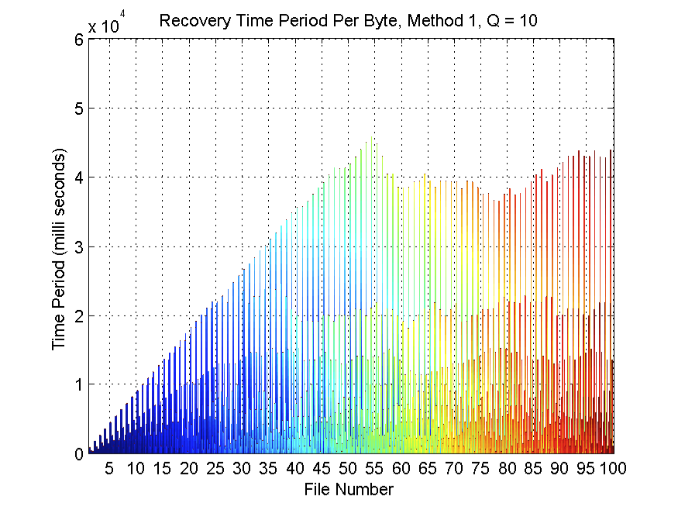
3.2.4 Experimental Evaluation (cont.)
Recovery time period per byte;

Slide 113
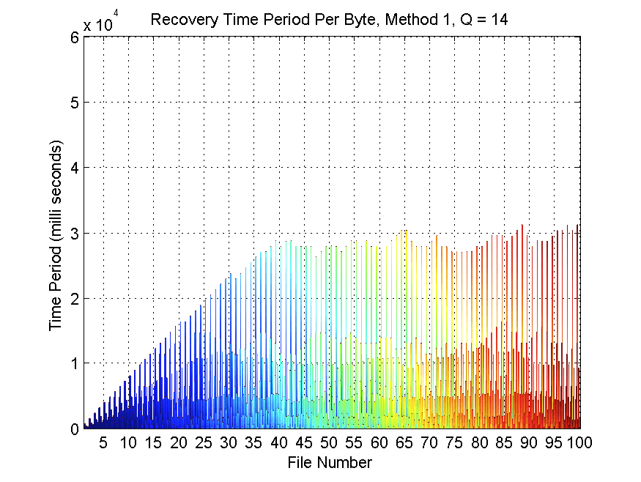
3.2.4 Experimental Evaluation (cont.)
Recovery time period per byte;

Slide 114
3.2.4 Experimental Evaluation (cont.)
File lifetime information progression;

Slide 115
3.2.4 Experimental Evaluation (cont.)
File lifetime information progression;

Slide 116
3.2.4 Experimental Evaluation (cont.)
File lifetime information progression;

Slide 117
3.2.4 Experimental Evaluation (cont.)
File lifetime information progression;

Slide 118
3.2.4 Experimental Evaluation (cont.)
File lifetime information progression;

Slide 119
3.2.4 Experimental Evaluation (cont.)
File lifetime information progression;

Slide 120
3.3 Tag Storage Lifetime and Tag Granularity
Relate tag dynamics with tag storage
Tags enter area according to Poisson
Tag lifetime is exponential

Slide 121
3.3 Tag Storage Lifetime and Tag Gran (cont.)
Scan range of R meters; capture S tags per scan
Increasing by a multiplicative factor N only changes inter-tag distance by a multiplicative factor of

Slide 122
3.3 Tag Storage Lifetime and Tag Gran (cont.)

Slide 123
3.4 Continuous Pervasivity

Slide 124
3.4.1 Quality of Storage Services
Desire diversity in services
Storage associated with multiple user-oriented features

Slide 125
3.4.2 Distributedness
Different ways to design large-scale tag-based information systems
Creates many design opportunities for privacy
Fault-tolerant designs in storage systems

Slide 126
3.5 Concluding Remarks
Two storage scenarios
Dense tag distribution
Efficient tag access algorithms
Moderate tag distribution
Random access file system
Tag storage lifetime and tag granularity

Slide 127
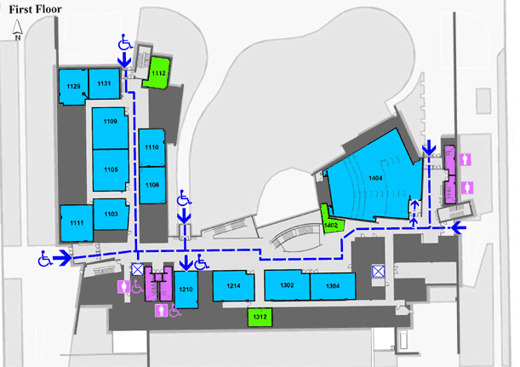
4 Distributed Passive RFID Computing
Image credit: Facilities and Services (http://www.fs.uiuc.edu/ada/0563Plan1.gif)

Slide 128
4 Distributed Passive RFID Computing
Computing-based metrics in a tag-based information system
Both local and system level

Slide 129
4.1 Local Computations
Local computations lead to system-wide effects
First study local
Physical tag parameters relate to computing speed
Computer instructions (including data) stored in tags

Slide 130
4.1 Local Computations (cont.)

Slide 131
4.1 Local Computations (cont.)
Scan, read, execute, and write

Slide 132
4.1 Local Computations (cont.)

Slide 133
4.1 Local Computations (cont.)

Slide 134
4.2 System Model
Physical space is a disk
Tags randomly distributed at fixed locations
Only interrogator moving in disk at any time
Start at random location
Scan tags
Move to another random location
Repeat for fixed number of times

Slide 135
4.2 System Model (cont.)
Levy distribution

Slide 136
4.2 System Model (cont.)
Truncated Levy distribution

Slide 137
4.3 Simulations

Slide 138
4.3.1 Interrogator Dynamics
Focus on interrogator steps
System radius = r = 50

Slide 139
4.3.1 Interrogator Dynamics (cont.)
behavior of interrogator steps

Slide 140
4.3.1 Interrogator Dynamics (cont.)
PDF of Levy and truncated Levy distributions

Slide 141
4.3.1 Interrogator Dynamics (cont.)
Interrogator trajectories;
number of interrogators = 5 and number of interrogator steps = 4

Slide 142
4.3.1 Interrogator Dynamics (cont.)
Interrogator trajectories;
number of interrogators = 5 and number of interrogator steps = 4

Slide 143
4.3.1 Interrogator Dynamics (cont.)
Interrogator trajectories;
number of interrogators = 5 and number of interrogator steps = 4

Slide 144
4.3.2 System Performance
System connectivity
Tags
Connected link
System connectivity

Slide 145
4.3.2 System Performance (cont.)
System connectivity;
number of interrogators = 10 and number of interrogator steps = 20

Slide 146
4.3.2 System Performance (cont.)
System connectivity;
number of interrogators = 10 and number of interrogator steps = 20

Slide 147
4.3.2 System Performance (cont.)
System connectivity;
number of interrogators = 10 and number of interrogator steps = 20

Slide 148
4.3.2 System Performance (cont.)
System connectivity;
number of interrogators = 10 and number of interrogator steps = 20

Slide 149
4.3.2 System Performance (cont.)
First time reaching system connectivity;
number of interrogators = 10 and number of interrogator steps = 20

Slide 150
4.3.2 System Performance (cont.)
First time reaching system connectivity;
number of interrogators = 10 and number of interrogator steps = 20

Slide 151
4.3.2 System Performance (cont.)
Connected links system metrics
Tags
Set of distances
Connected links minimum distances systems average

Slide 152
4.3.2 System Performance (cont.)
System connected links minimum distances average

Slide 153
4.3.2 System Performance (cont.)
System connected links minimum distances average

Slide 154
4.3.2 System Performance (cont.)
System connected links minimum distances average

Slide 155
4.3.2 System Performance (cont.)
System connected links minimum distances average

Slide 156
4.3.2 System Performance (cont.)
Connected links system metric
Connected links maximum distances systems average

Slide 157
4.3.2 System Performance (cont.)
System connected links maximum distances average

Slide 158
4.3.2 System Performance (cont.)
System connected links maximum distances average

Slide 159
4.3.2 System Performance (cont.)
System connected links maximum distances average

Slide 160
4.3.2 System Performance (cont.)
System connected links maximum distances average

Slide 161
4.3.2 System Performance (cont.)
System connected links displacements average

Slide 162
4.3.2 System Performance (cont.)
System connected links displacements average

Slide 163
4.3.2 System Performance (cont.)
System connected links displacements average

Slide 164
4.3.2 System Performance (cont.)
System connected links displacements average

Slide 165
4.3.3 Single Interrogator Performance
Only focus on current interrogator
Single interrogator connectivity
Single interrogator summation of connected links minimum distances, maximum distances, and displacements

Slide 166
4.3.3 Single Interrogator Performance (cont.)
Single interrogator connectivity

Slide 167
4.3.3 Single Interrogator Performance (cont.)
Single interrogator connectivity

Slide 168
4.3.3 Single Interrogator Performance (cont.)
Single interrogator summation of connected links minimum distances

Slide 169
4.3.3 Single Interrogator Performance (cont.)
Single interrogator summation of connected links minimum distances

Slide 170
4.3.3 Single Interrogator Performance (cont.)
Single interrogator summation of connected links maximum distances

Slide 171
4.3.3 Single Interrogator Performance (cont.)
Single interrogator summation of connected links maximum distances

Slide 172
4.3.3 Single Interrogator Performance (cont.)
Single interrogator summation of connected links displacements

Slide 173
4.3.3 Single Interrogator Performance (cont.)
Single interrogator summation of connected links displacements

Slide 174
4.3.4 Time Utilization
Want to maximize useful time
Computation time
Levy distribution of pause time

Slide 175
4.3.4 Time Utilization (cont.)

Slide 176
4.3.4 Time Utilization (cont.)
Expected time utilization

Slide 177
4.3.4 Time Utilization (cont.)
Maximum expected time utilization

Slide 178
4.3.4 Time Utilization (cont.)
Maximizing required computation time

Slide 179
4.4 Continuous Pervasivity
Local computing
Local computing merging into distributed computing
Fault-tolerance
Efficient costs in computation

Slide 180
4.5 Concluding Remarks
Distributed passive RFID computing
Local interactions
Extend to system-wide effects

Slide 181
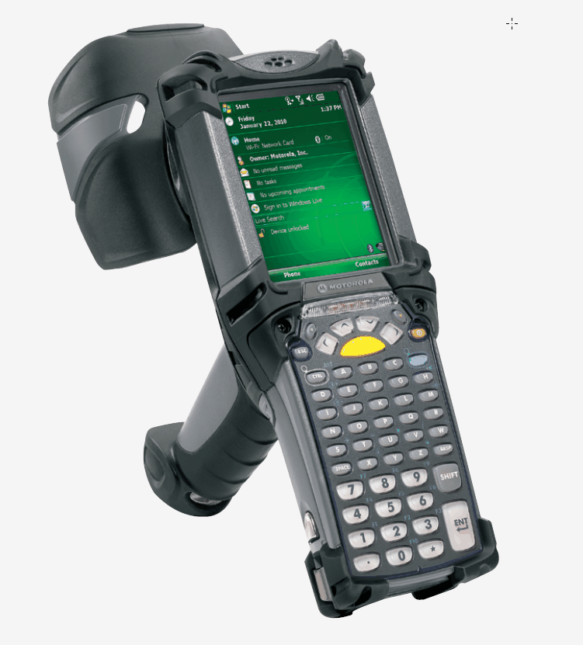
5. Conclusion
Image credit: Motorola

Slide 182
5.1 Summary of Work
Chapter 1
Introduce thesis: Tag multiplicity → continuous pervasive spaces
Chapter 2
Tracking protocols in two scenarios
Chapter 3
Storage systems in two scenarios
Chapter 4
Distributed passive computing

Slide 183
5.2 Continuous Pervasivity
Service richness and elasticity
Minimum user distraction
System distributedness and scalability
Energy-efficiency and cost-efficiency

Slide 184
5.2 Continuous Pervasivity (cont.)
Passive RFID enables the design and implementation of continuous pervasive spaces. In particular, a large number of tags, that is, passive RFID tag multiplicity, allows us to design and deploy robust, distributed physical information systems, achieving this particular goal of pervasivity.

Slide 185
5.3 Final Remarks
Current RFID business drivers
Identification
Visibility
Tracking
Future
Beyond supply chain
Prediction and smart systems
Pervasivity

